Slide 1
Snacking on Exercise: Desk Edition
Bry Bellovary, PhD, CSCS,*D, NSCA-CPT,*D
Kinesiology Department

Slide 2
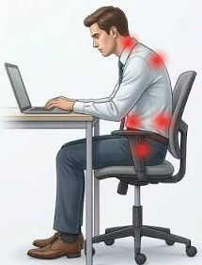
Why should I move?
Higher Ed self-reported sitting:
Faculty: ~5.4 – 6.6 hr./day
Staff: ~5.6 - 6.2 hr./day
Common issues from prolonged sitting:
Neck & shoulder tension
Lower back pain
Wrist discomfort
Tight hips
(Fountaine et al., 2014; Headley et al., 2018; Jones et al., 2021)

Slide 3
How much should I move?
Goal: 150 min/week of moderate-intensity PA
Myth: Movement must be prolonged, constant & gets the heart rate up to count
Exercise Snacks: brief exercise session (≤1 min) spaced at intervals over 1-4 hr./day
Goal: accumulate ~30 total min/day
(Wang et al., 2025; WHO, 2020)

Slide 4
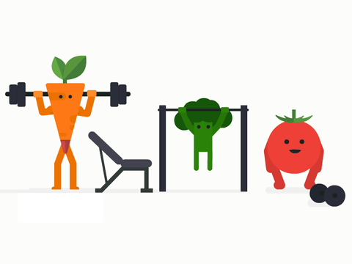
Exercise Snacks
Benefits from consistent use:
↑ cardio fitness 4.6-17.1%
↑ muscular endurance
↑ energy expenditure
↓ blood sugar levels*
↓ blood lipid levels*
(Rodríguez et al., 2026; Wang et al., 2025)

Slide 5
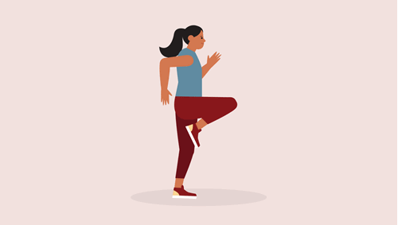
How do I start?
General recommendations:
Move slowly
Move without pain
Focus on posture
Breathe
Aim for 1-2 min every hr.

Slide 6


Slide 7
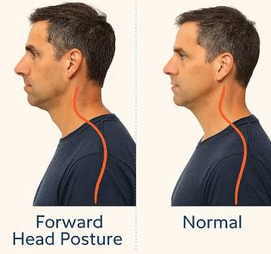
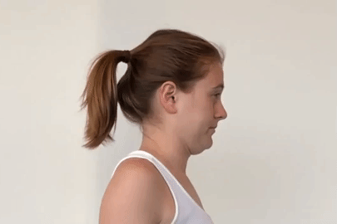
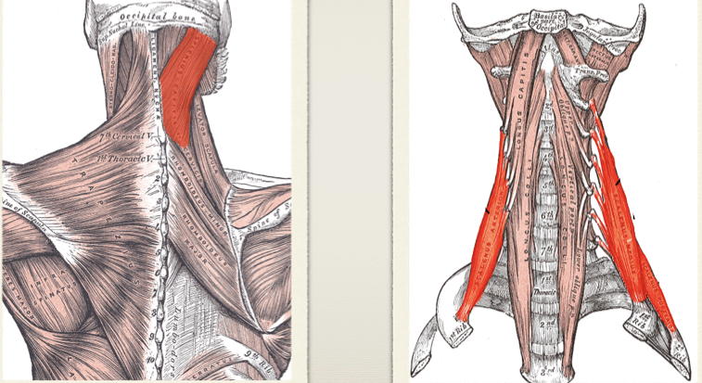
Neck
Chin Tucks
Glide head horizontally backward
Hold 3-5 sec. & repeat 5x

Slide 8
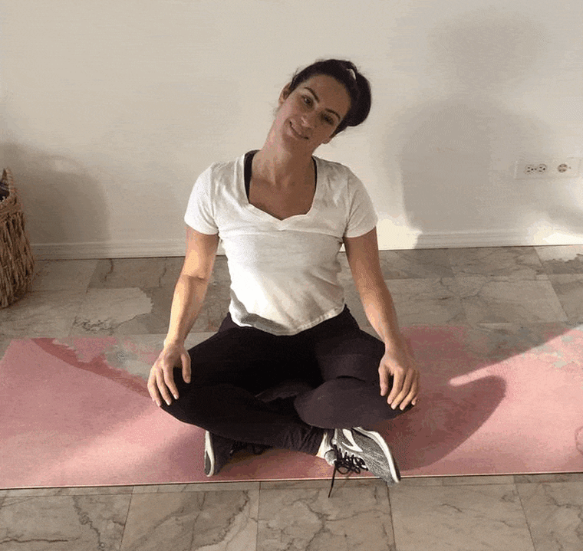
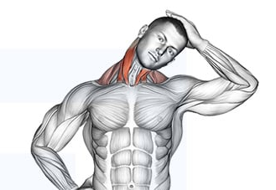
Neck
Neck Side Stretch
Ear toward shoulder, gentle tension
Hold 3-5 sec. & repeat 5x ea. side

Slide 9
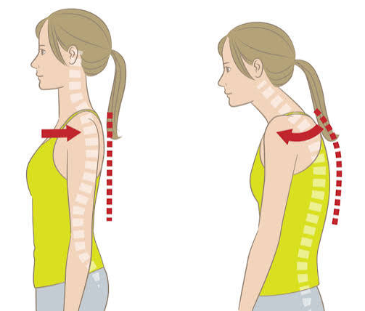
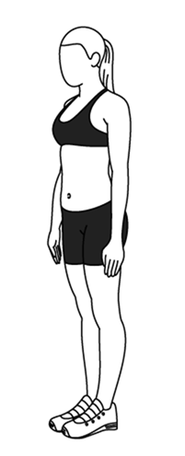
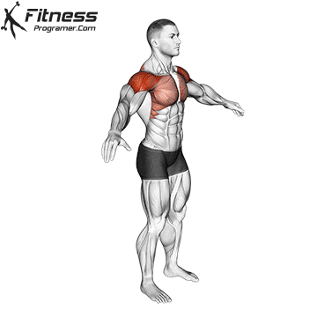
Shoulders
Shoulder Rolls
Small rolls
Forward & Backward 5x

Slide 10
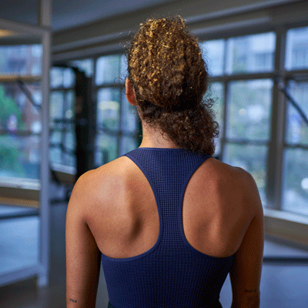
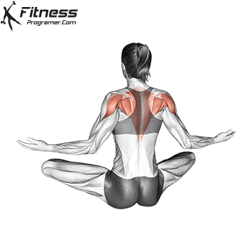
Shoulders
Shoulder Blade Squeezes
Pinch shoulder blades together
Hold 3-5 sec. & repeat 5x

Slide 11
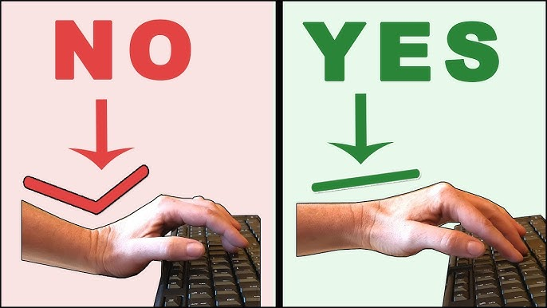
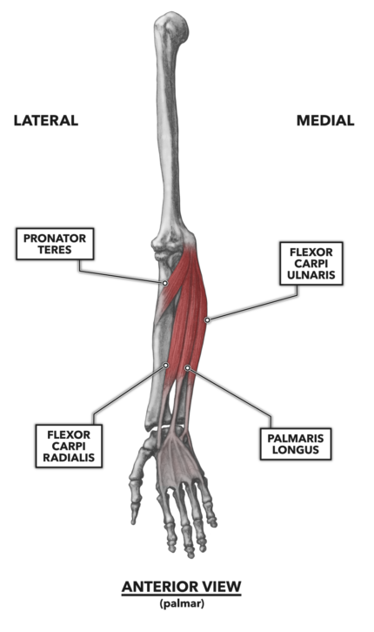
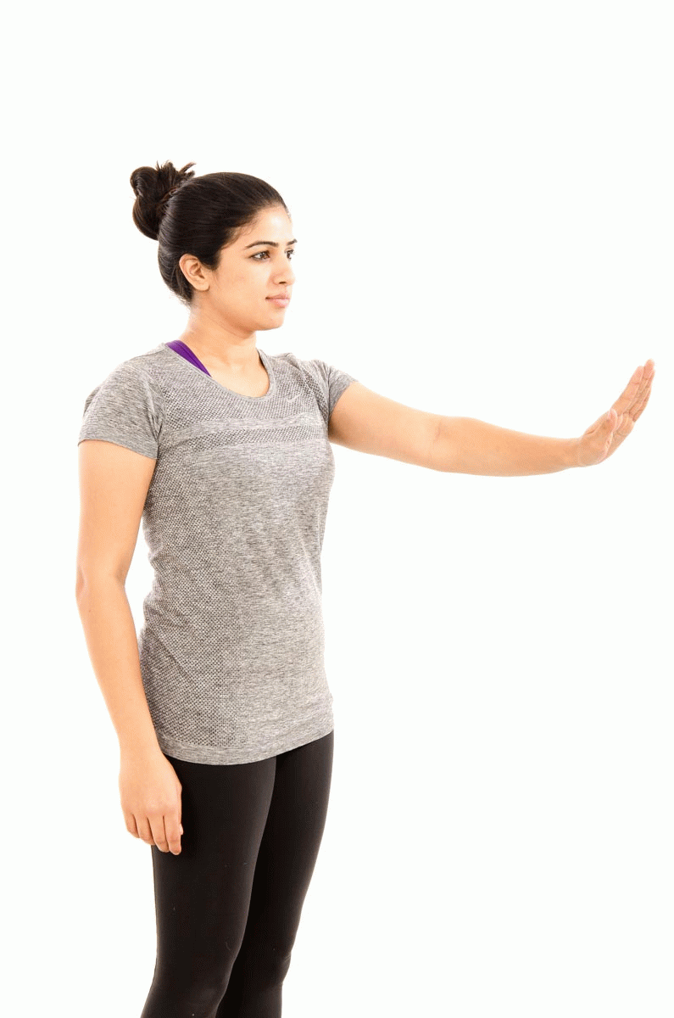
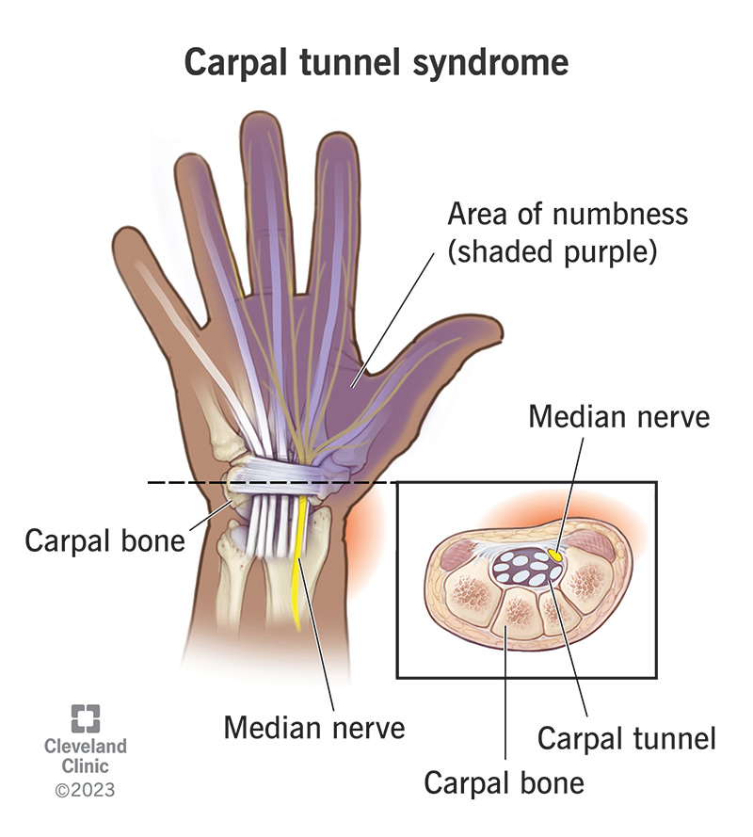
Wrist & Hand
Wrist Flexor Stretch
Gentle tension
Hold 3-5 sec.
Repeat 5x

Slide 12
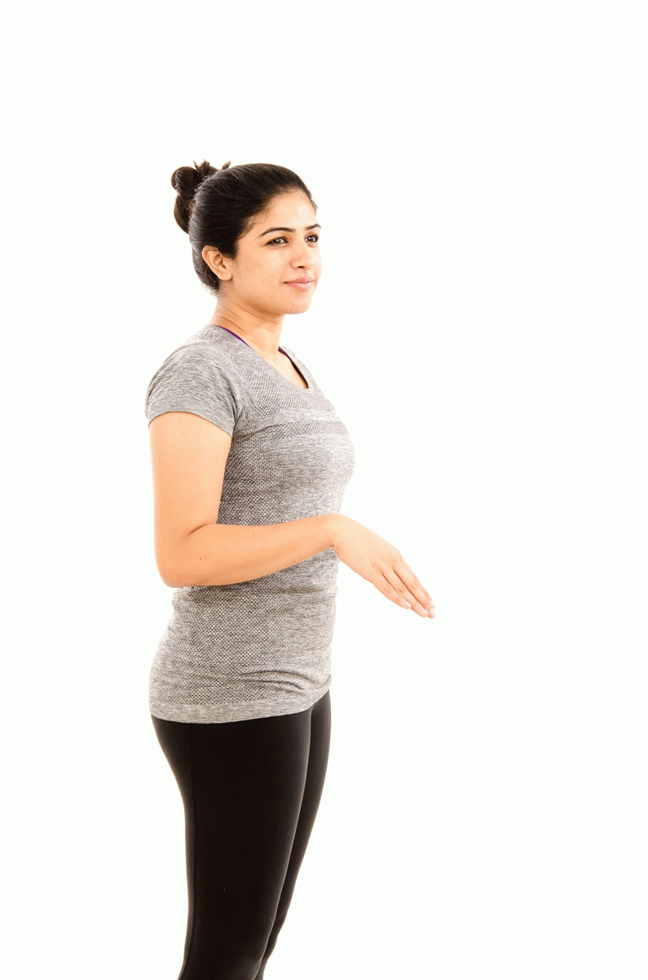
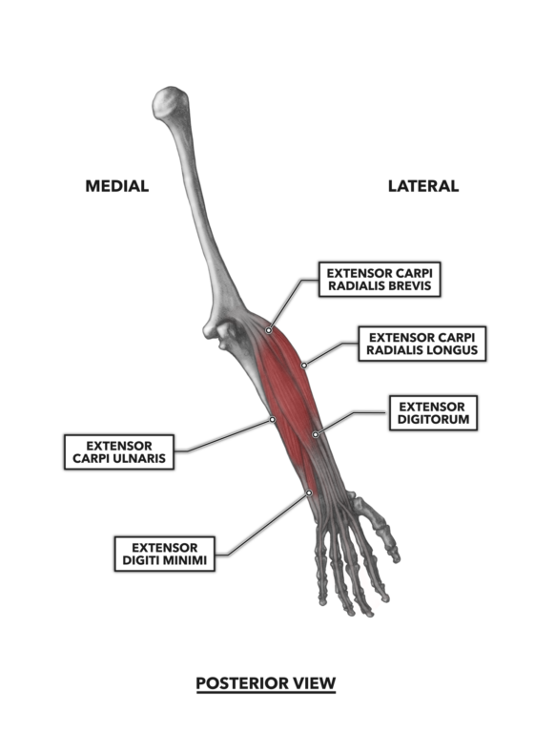
Wrist & Hand
Wrist Extensor Stretch
Gentle tension
Hold 3-5 sec.
Repeat 5x

Slide 13
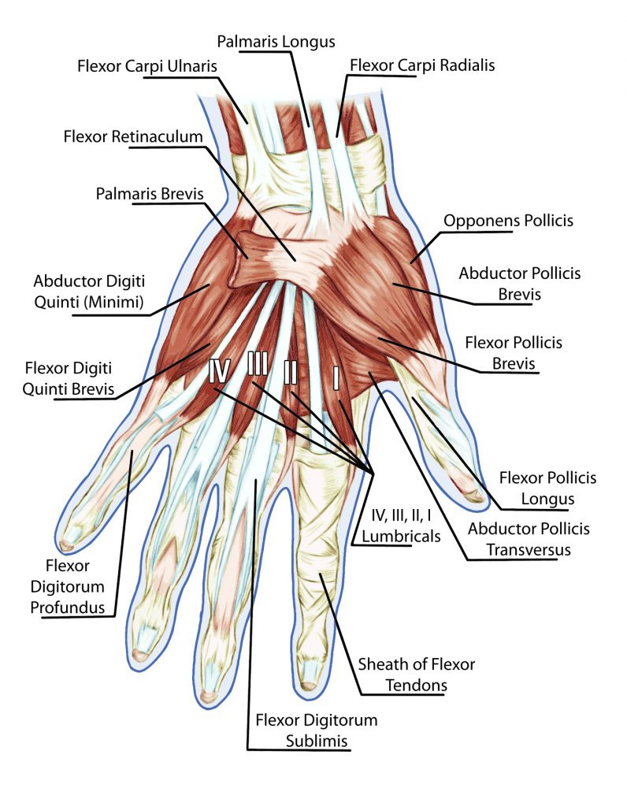
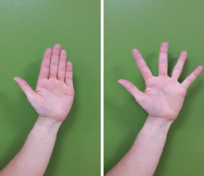
Wrist & Hand
Finger Spreads
Fingers toward to spread out
Gentle tension
Hold 3-5 sec.
Repeat 5x

Slide 14
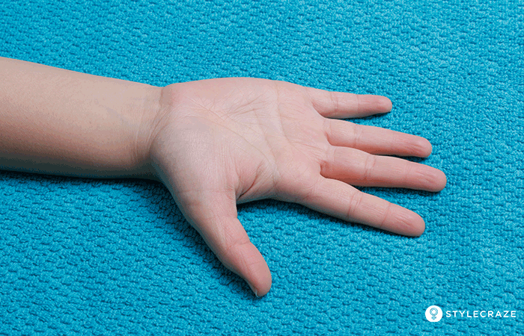
Wrist & Hand
Grip & Release
Fist to finger extension
Gentle tension
Hold 3-5 sec.
Repeat 5x

Slide 15
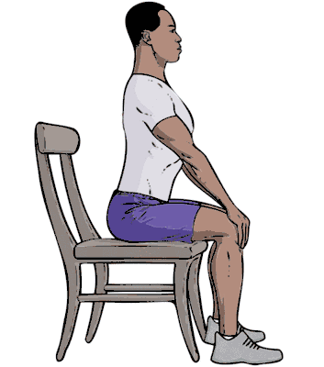
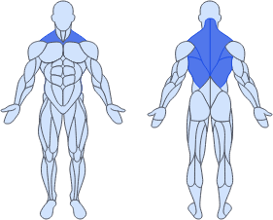
Upper Body
Seated Cat-Cow
Hands rest on knees for support
Arch & round back
Move slowly
Hold 3-5 sec.
Repeat 5x

Slide 16
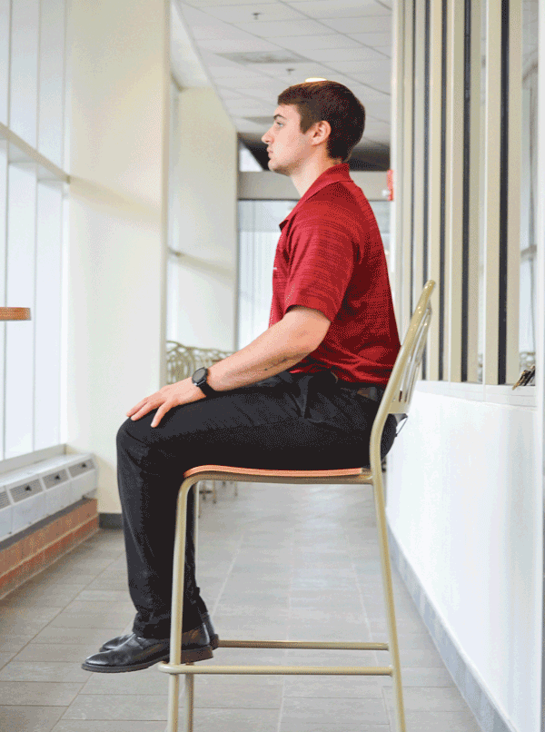
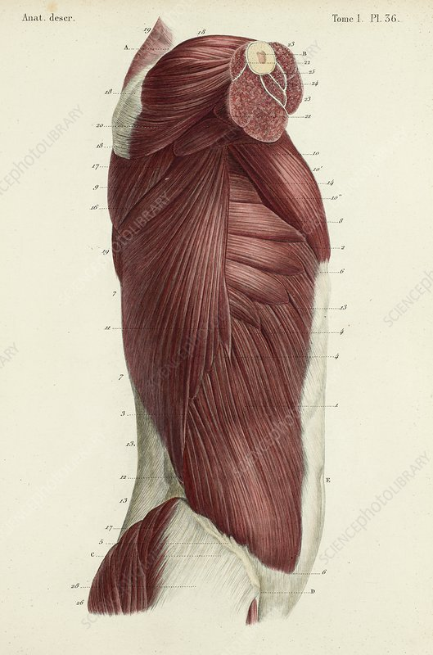
Upper Body
Seated Truck Twist
Gentle rotation
Hand on knee for support
Look over shoulder
Hold 3-5 sec.
Repeat 5x ea. side

Slide 17
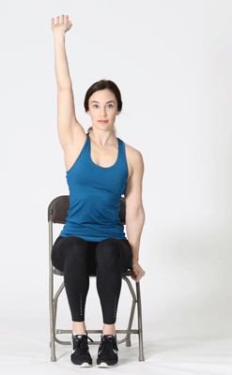
Upper Body
Seated Arm Reach
Reach overhead
Hand on chair/thigh for support
Gentle tension
Hold 3-5 sec.
Repeat 5x ea. side

Slide 18
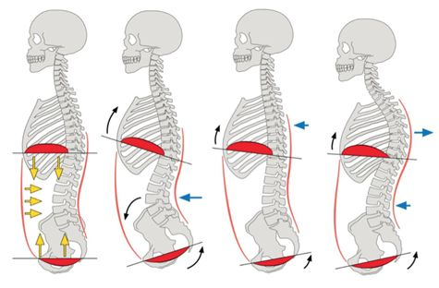
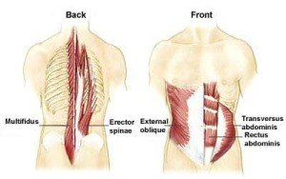
Upper Body
Seated Core Bracing
Sit tall & toward edge of seat
Tense deep abdominal muscles
Pull ribs down
Hold 5-10 sec.
Breathe
Repeat 5x

Slide 19
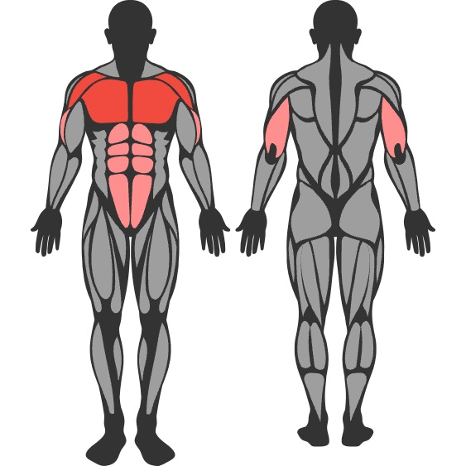
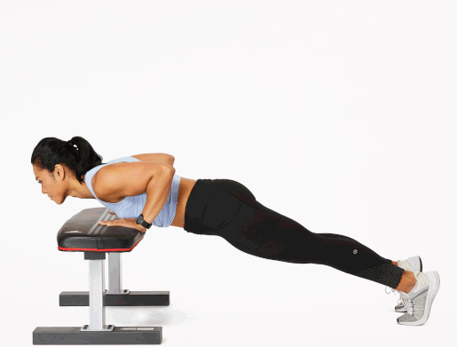
Upper Body
Incline Push-ups
Standing taller = easier
Hands under shoulders
Lower chest to desk
Repeat 5x

Slide 20
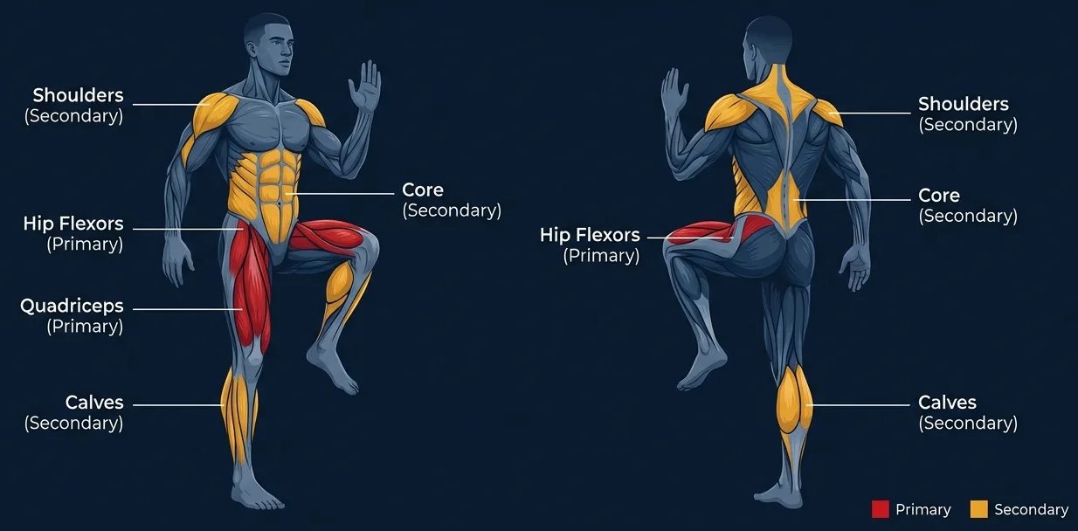
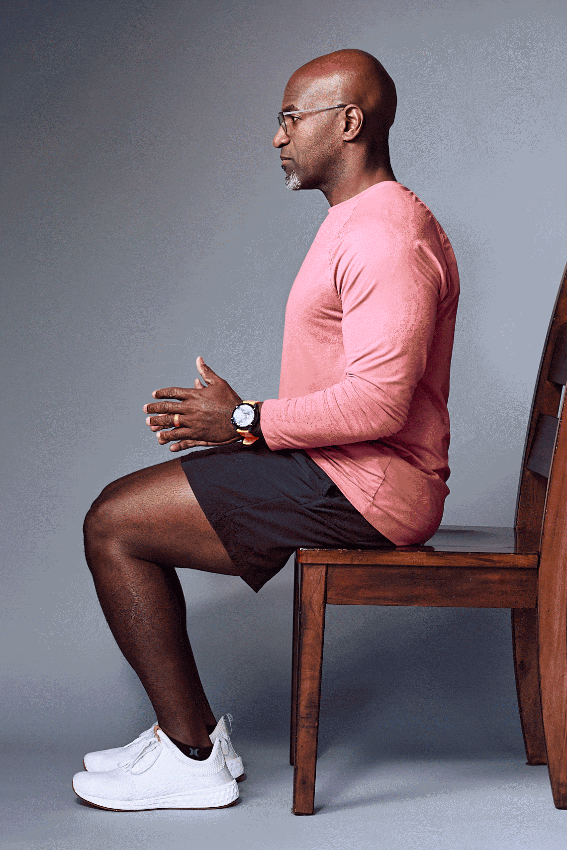
Lower Body
Seated Marching
Sit tall & toward edge of chair
Lift knee up
Move slowly
Repeat 5x ea. side

Slide 21
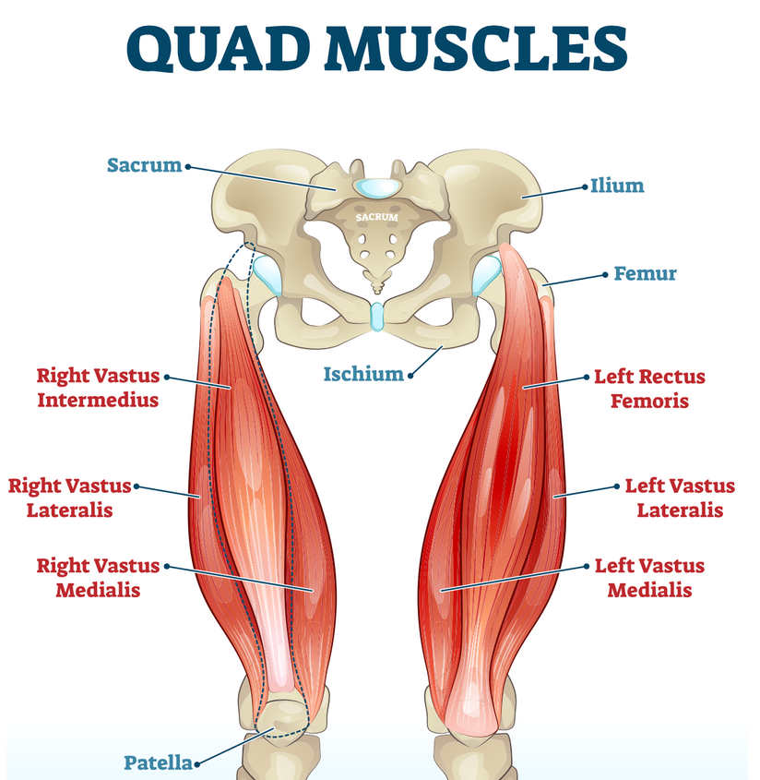
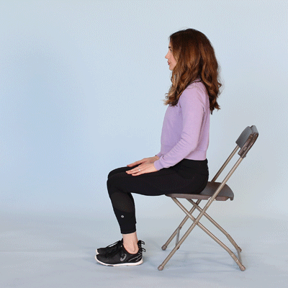
Lower Body
Leg Extension
Sit tall & toward edge of chair
Slightly lift knee so foot just off ground
Extend knee, gentle tension
Hold 3-5 sec. at top
Repeat 5x ea. side

Slide 22
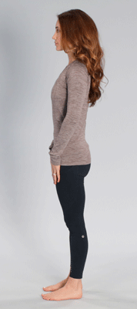
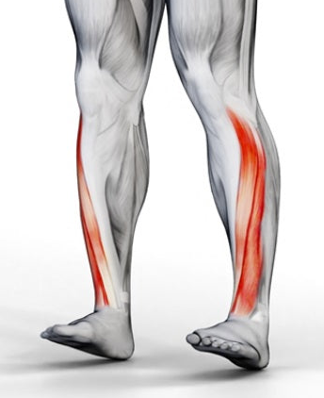
Lower Body
Seated Toe Raises
Sit tall & toward edge of chair
Feet flat on ground
Lift toe toward shin
Hold 3-5 sec.
Repeat 5x ea. side

Slide 23
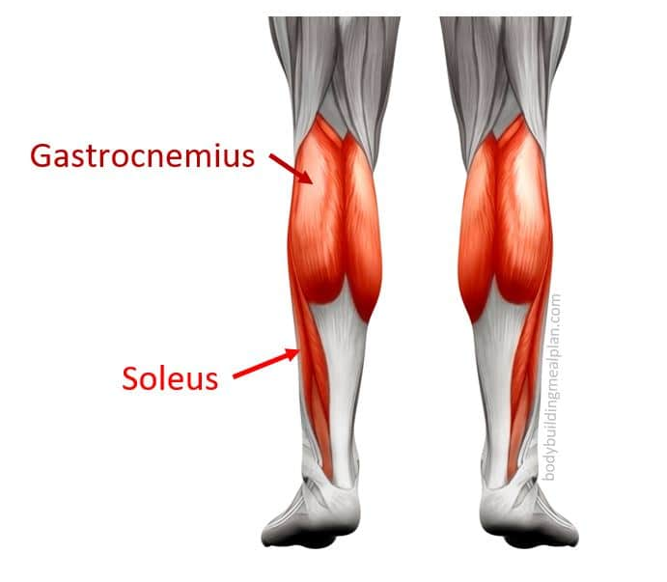
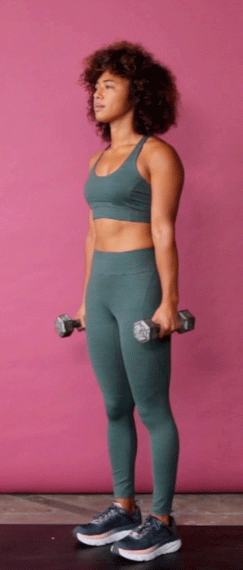
Lower Body
Heel Raises
Stand tall, hands rest on chair back for support
Lift heel off ground
Balance on ball of feet, even pressure
Hold 3-5 sec.
Repeat 5x

Slide 24
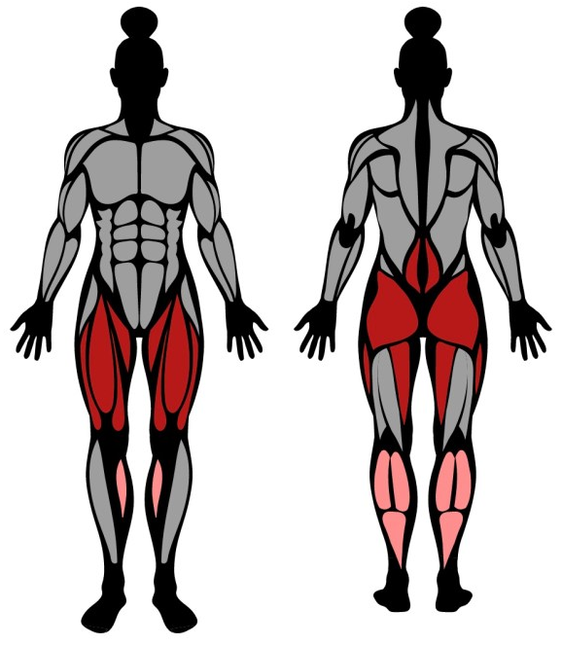
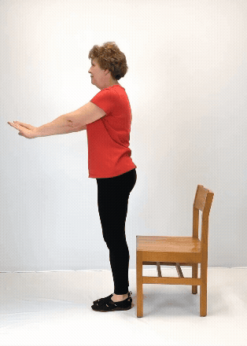
Lower Body
Chairs Stands
Sit tall & toward edge of chair
Feet flat on ground
Avoid rocking forward
Harder = slightly tap on seat then stand
Repeat 5x

Slide 25
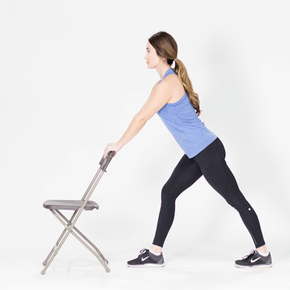
Lower Body
Standing Calf Stretch
Hands on desk/wall/chair back
One leg forward for support
Press heel toward ground
Gentle tension
Hold 3-5 sec.
Repeat 5x ea. side

Slide 26


Slide 27
What could I do in a day?
Time
Every hr.
Mid-morning
Lunch
Mid-afternoon
Activity
Stand 1-2 min
Neck & shoulder stretches
Short walk
Upper/lower body exercises

Slide 28

Biohacking Tip
Hydrate to Move
Drink your flavored water of choice
Think of it as forced movement
Turn it into a short walk

Slide 29
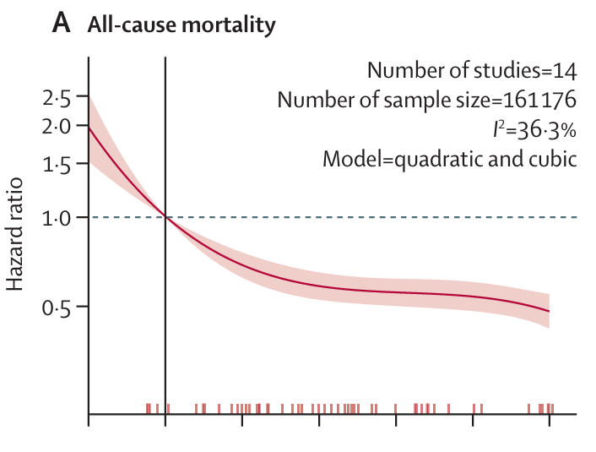

All Steps Count
Goal: at least 2K, but aim for minimum 7K steps/day
(Ding et al., 2025)

Slide 30

Questions?

